Slide 1

A Presentation on BMS
BANKING MANAGEMENT SYSTEM
Under Supervision of
Er. Om Prakash Mahato
Presented by:
Dinesh kumar Sarma
Abishek shahi

Slide 2

What is BMS…
Proper, transparent management of daily transaction such as cash deposit, cash withdraw, editing, creating accounts.
It also deals with transparent management of debits credits in case of any cross inspection by editors.

Slide 3
HOW IT IS DONE
Bank management system is simplex form of code of line which can be done under different environment of programming language POP and OOP
We have used object oriented programe c++
Using its function like
Class and object
Stream computation
Encapsulisation
Polymorphism

Slide 4
Why BMS
To reduce paperwork
To reduce time and labor
To make data more secure
To reduce data loss

Slide 5
Objective…
To bring whole bank record in single software
To create fast and reliable service of banking
To save time and labor of staff while keeping records
To reduce risk of loss of recorded data due to physical aspects

Slide 6
Scope…

Slide 7
Present scope of BMS in Nepal is increasing expontentially, while moving toward computerized world. Bank are more likely to move towards record keeping in computer servers and applications for keeping record rather than paper work.

Slide 8
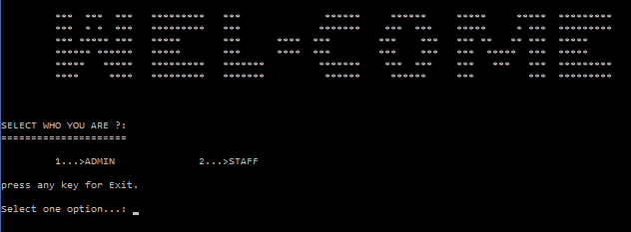
Main Menu…

Slide 9
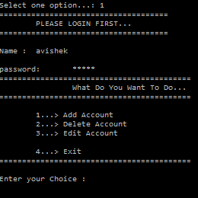
Admin Panel…

Slide 10
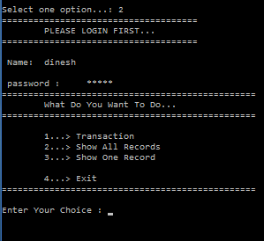
Staff Panel…

Slide 11
Limitations of BMS…
It can not read all details of customers like as: citizenship no, nationality.
It doesn’t provide us more security from hackers.
It doesn’t provide us More friendly GUI.

Slide 12
Conclusion…
By completing this project we gain the knowledge about software development.
We learned to Implement different characteristic OOP’s
Mainly we learned how to design oop’s program

Slide 13
Thank You… presented by Dinesh kumar sarma(071BCT-116) Abishek Shahi (071BCT-105)

